Slide 3
O Come all ye faithful

Slide 4
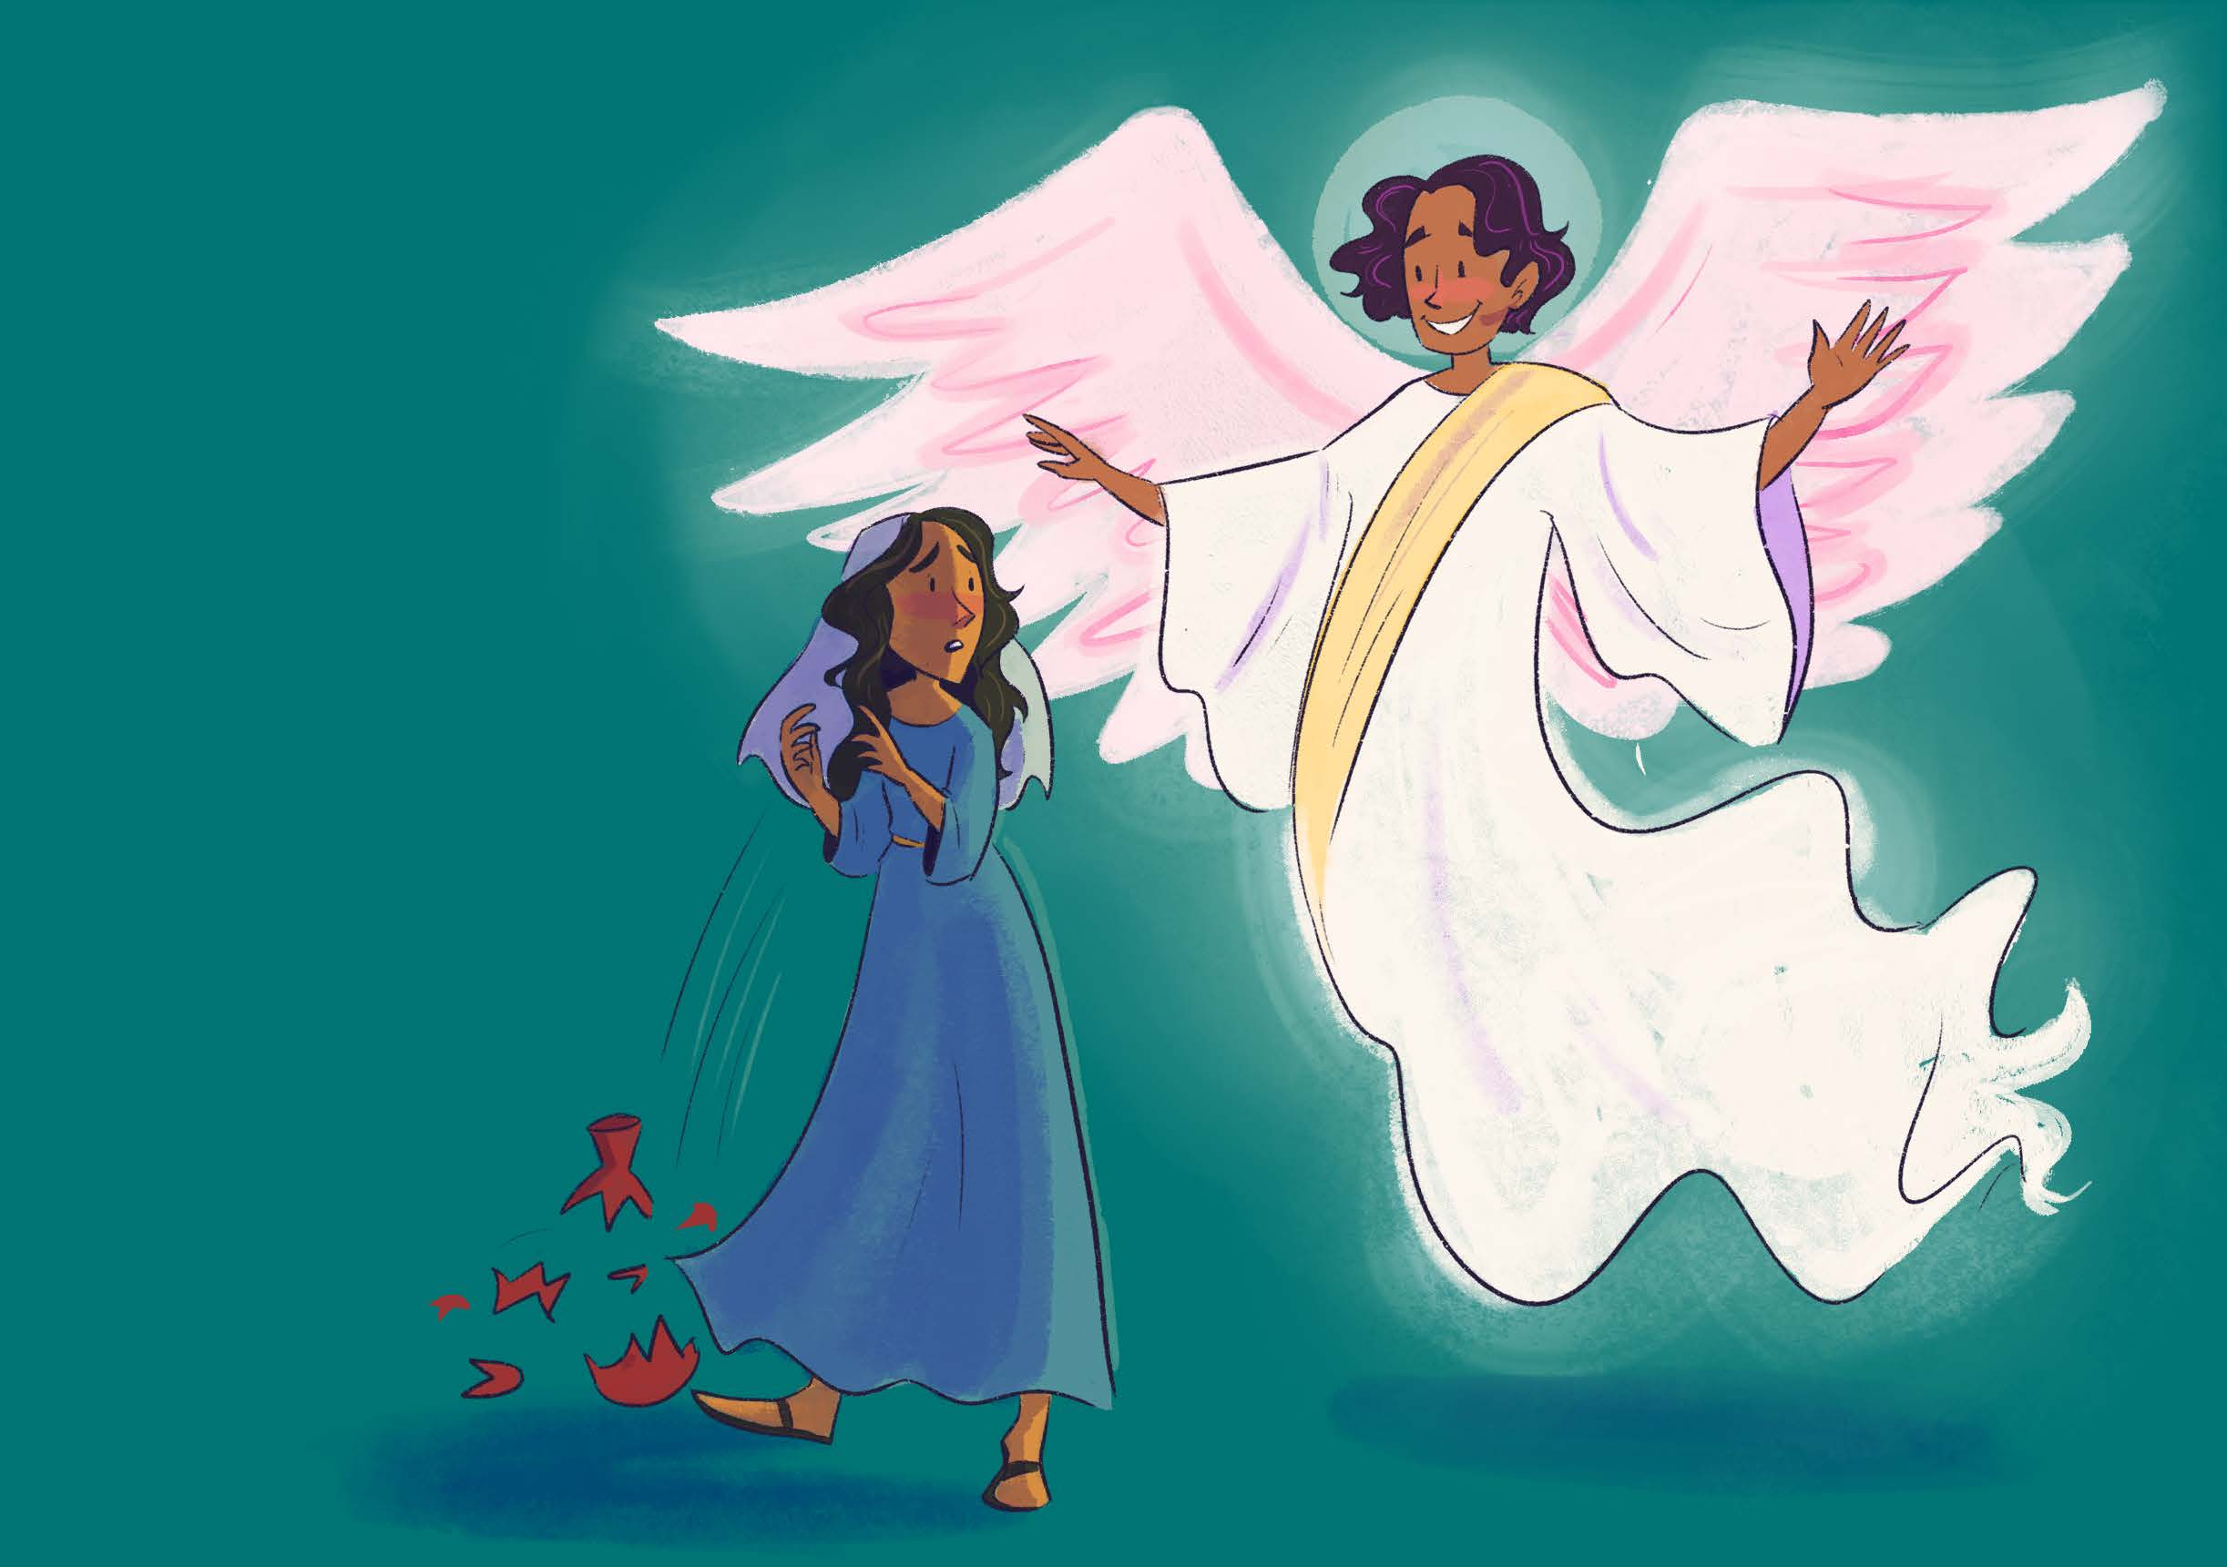

Slide 5
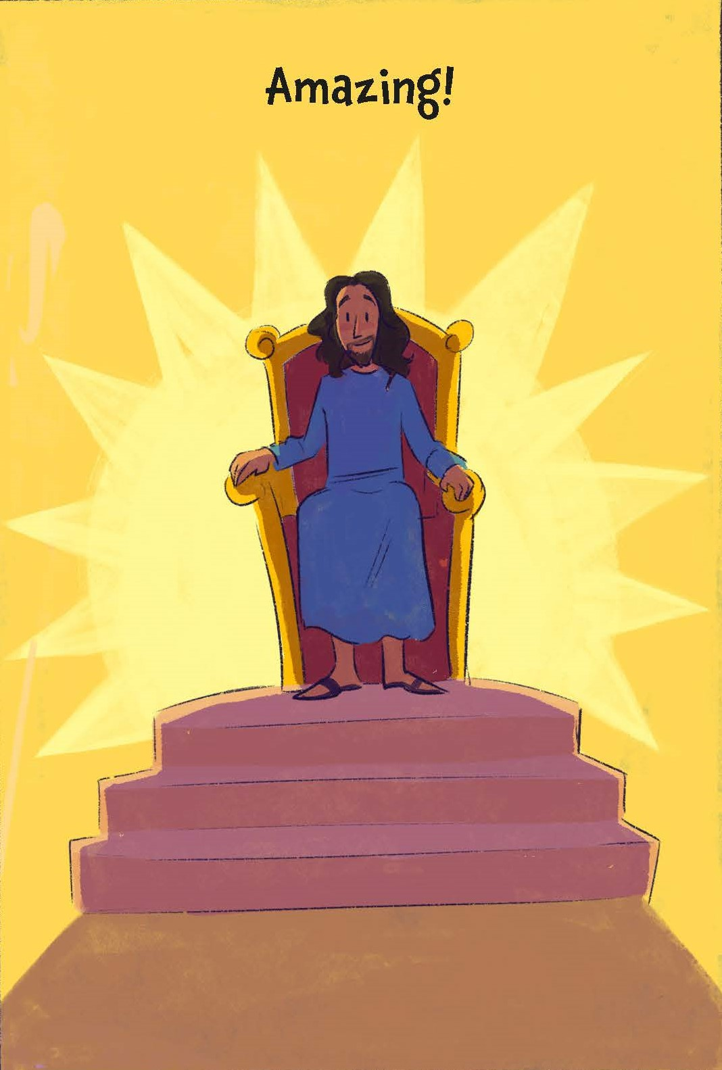

Slide 6
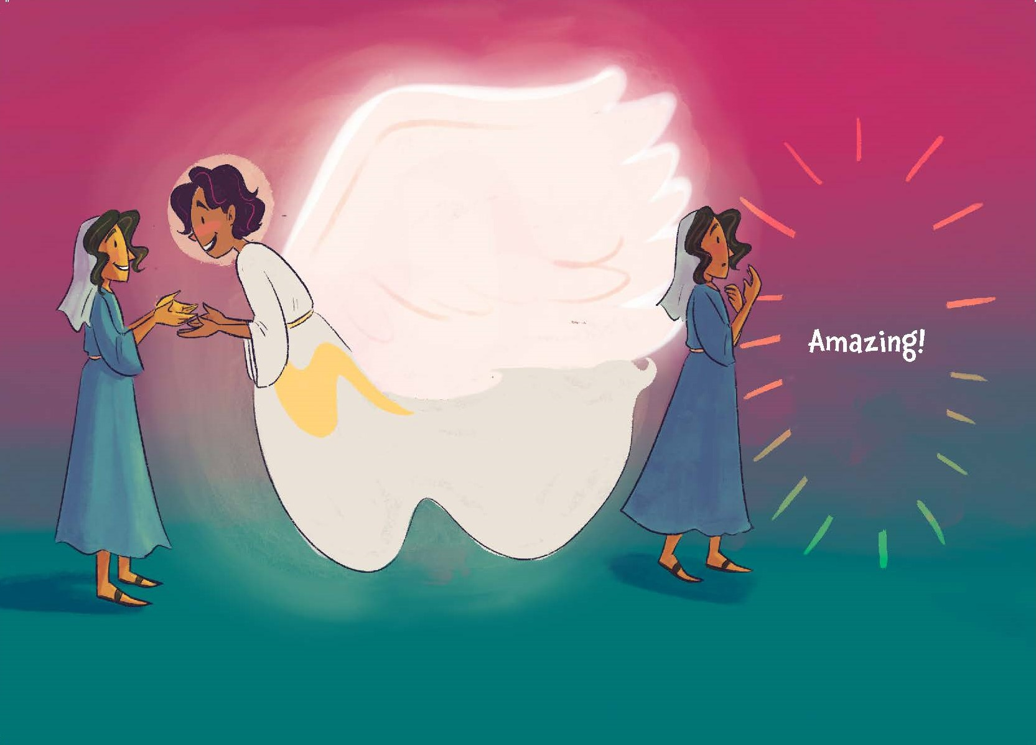

Slide 7
In the bleak midwinter

Slide 8
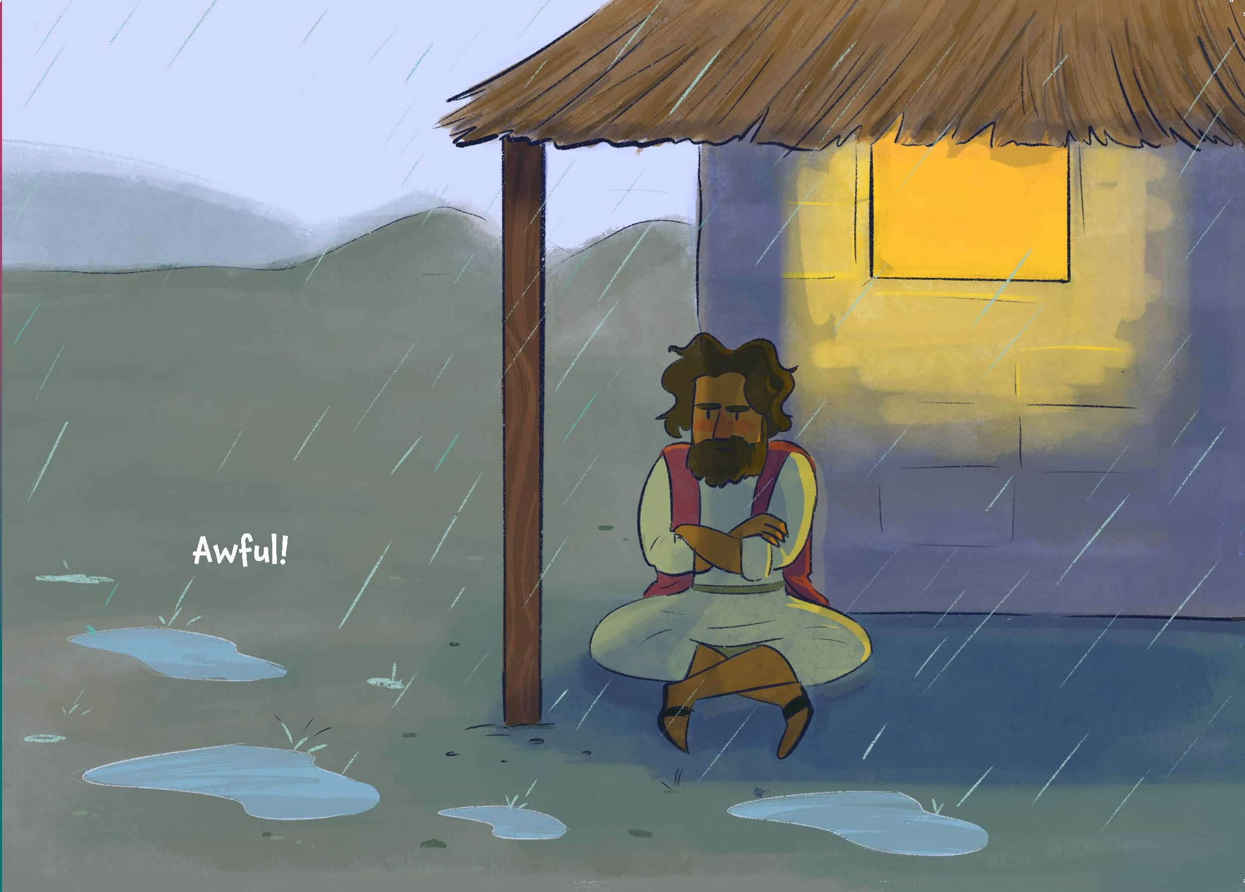

Slide 9
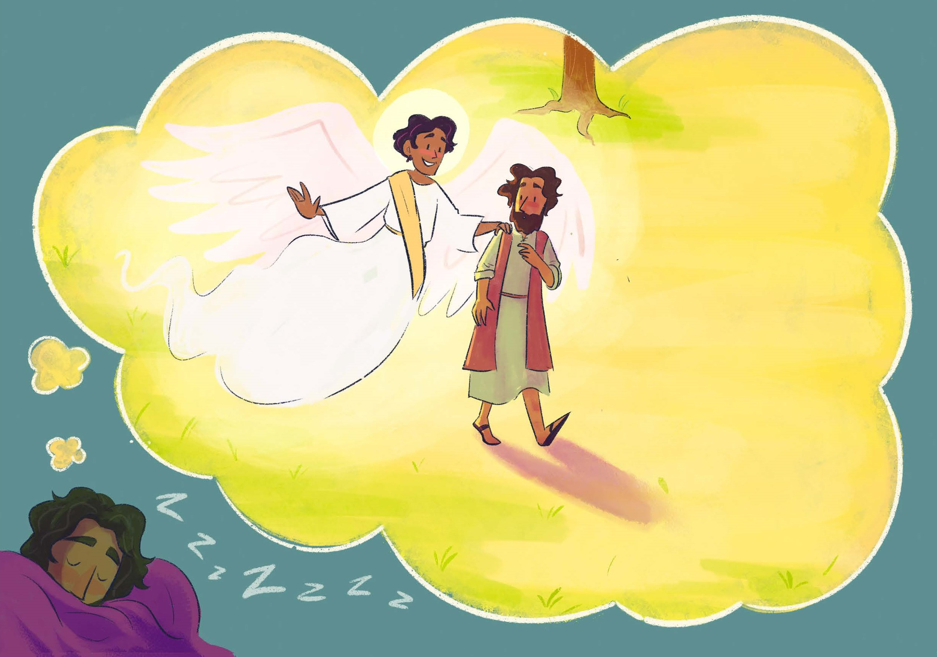

Slide 10
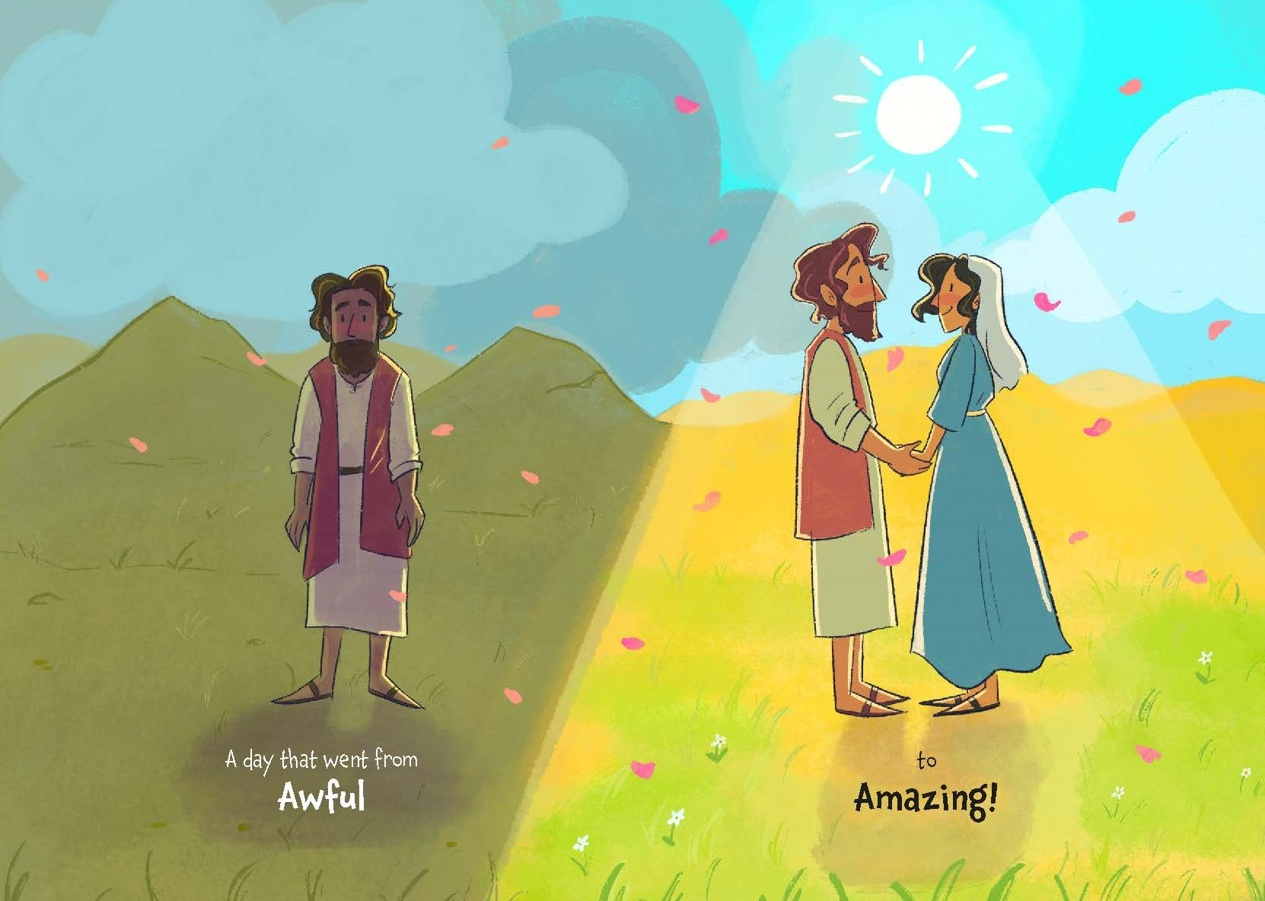

Slide 11
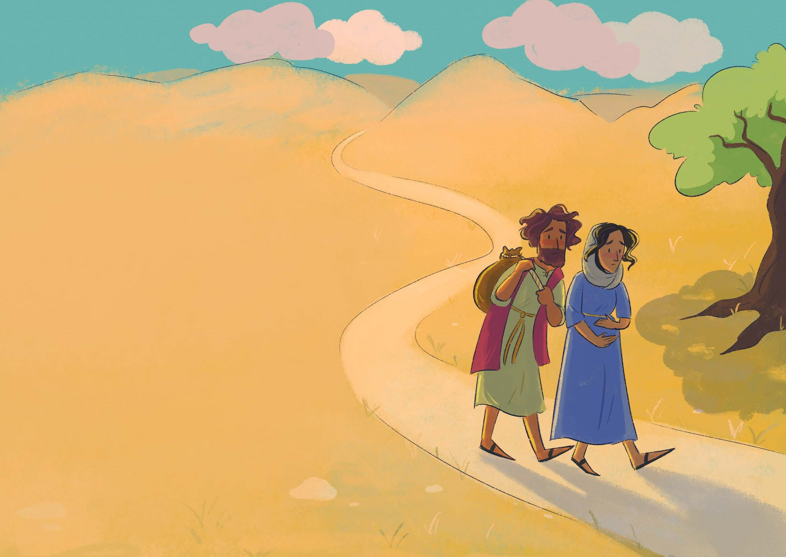

Slide 12
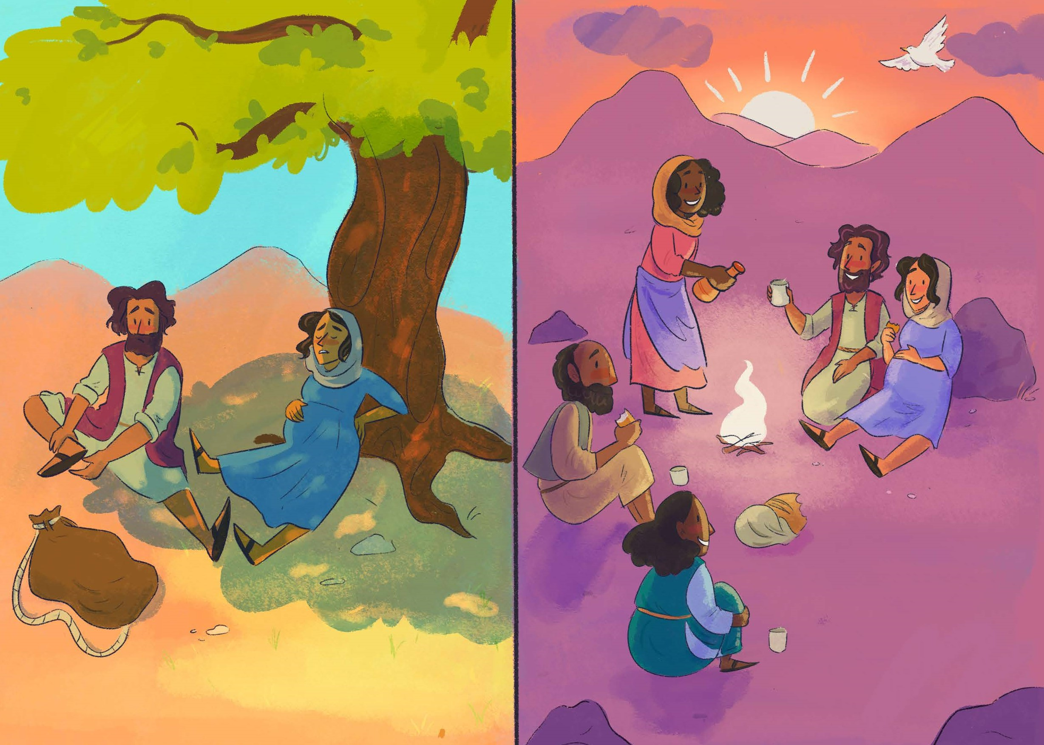

Slide 13
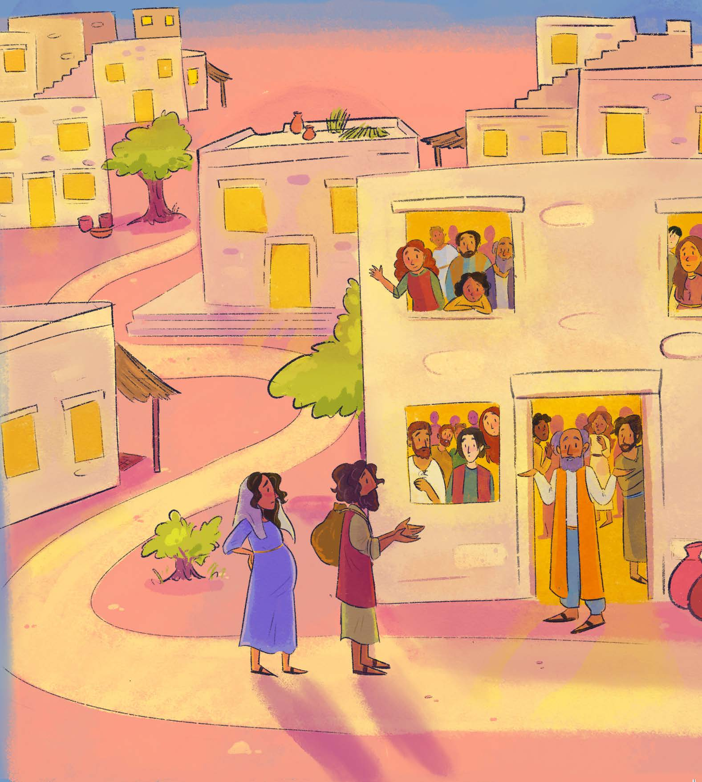

Slide 14
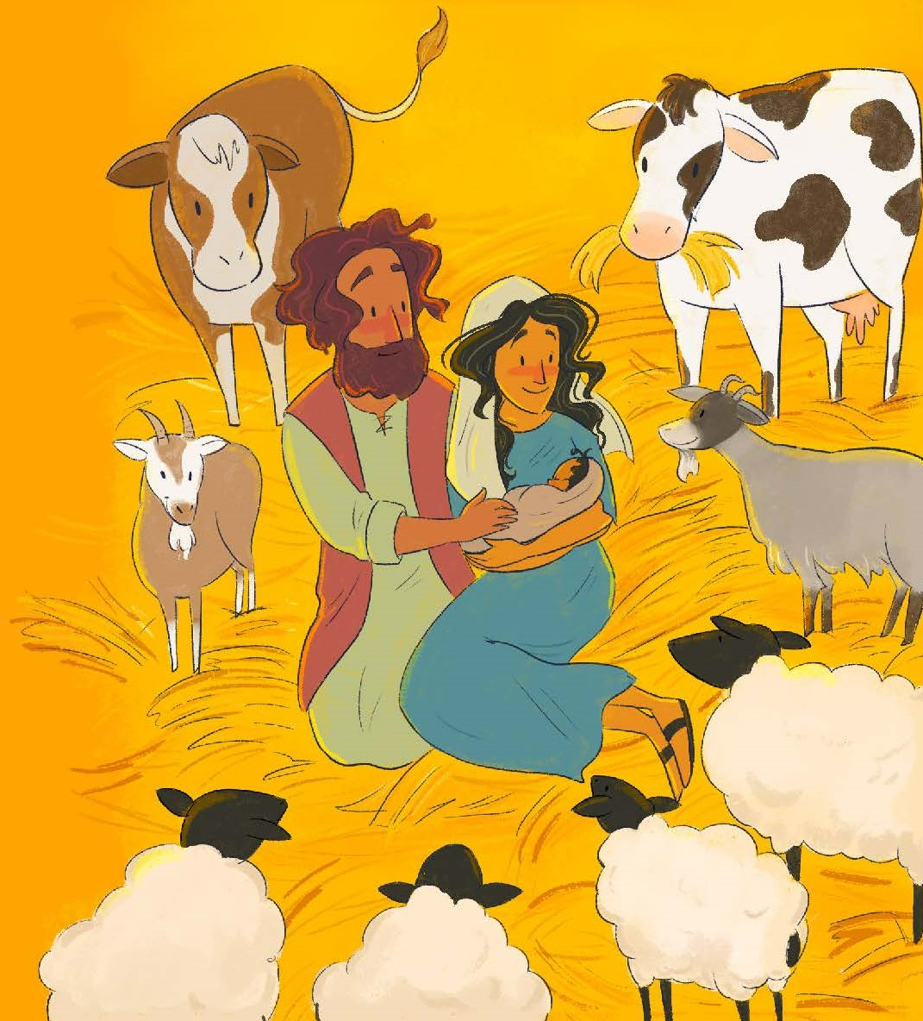

Slide 15
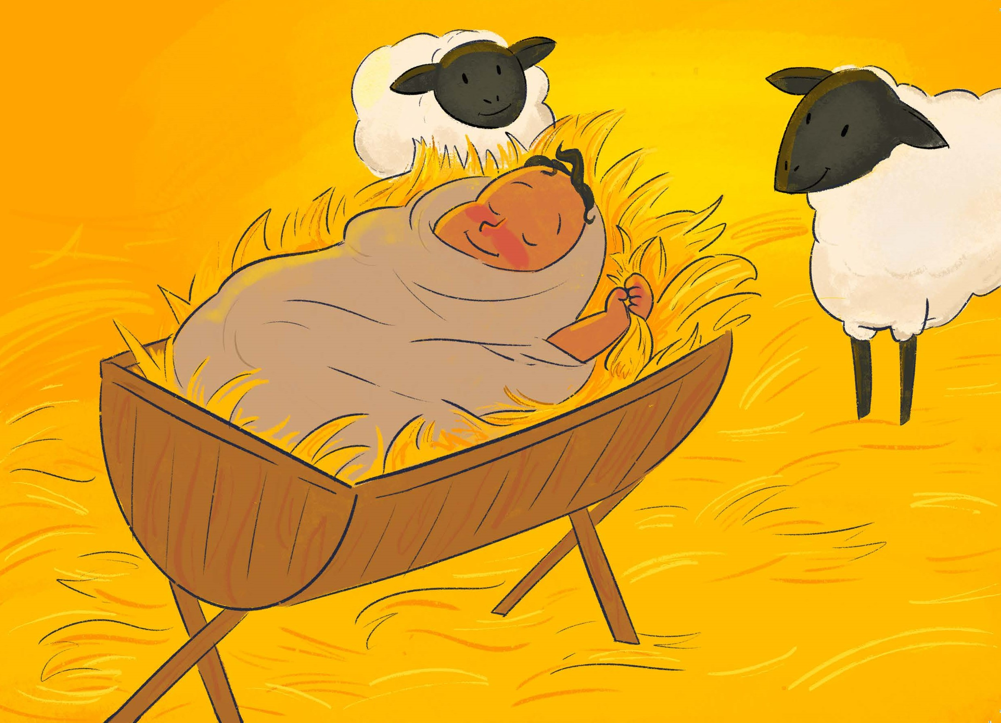

Slide 16
O little town of Bethlehem
Away in a manger

Slide 17
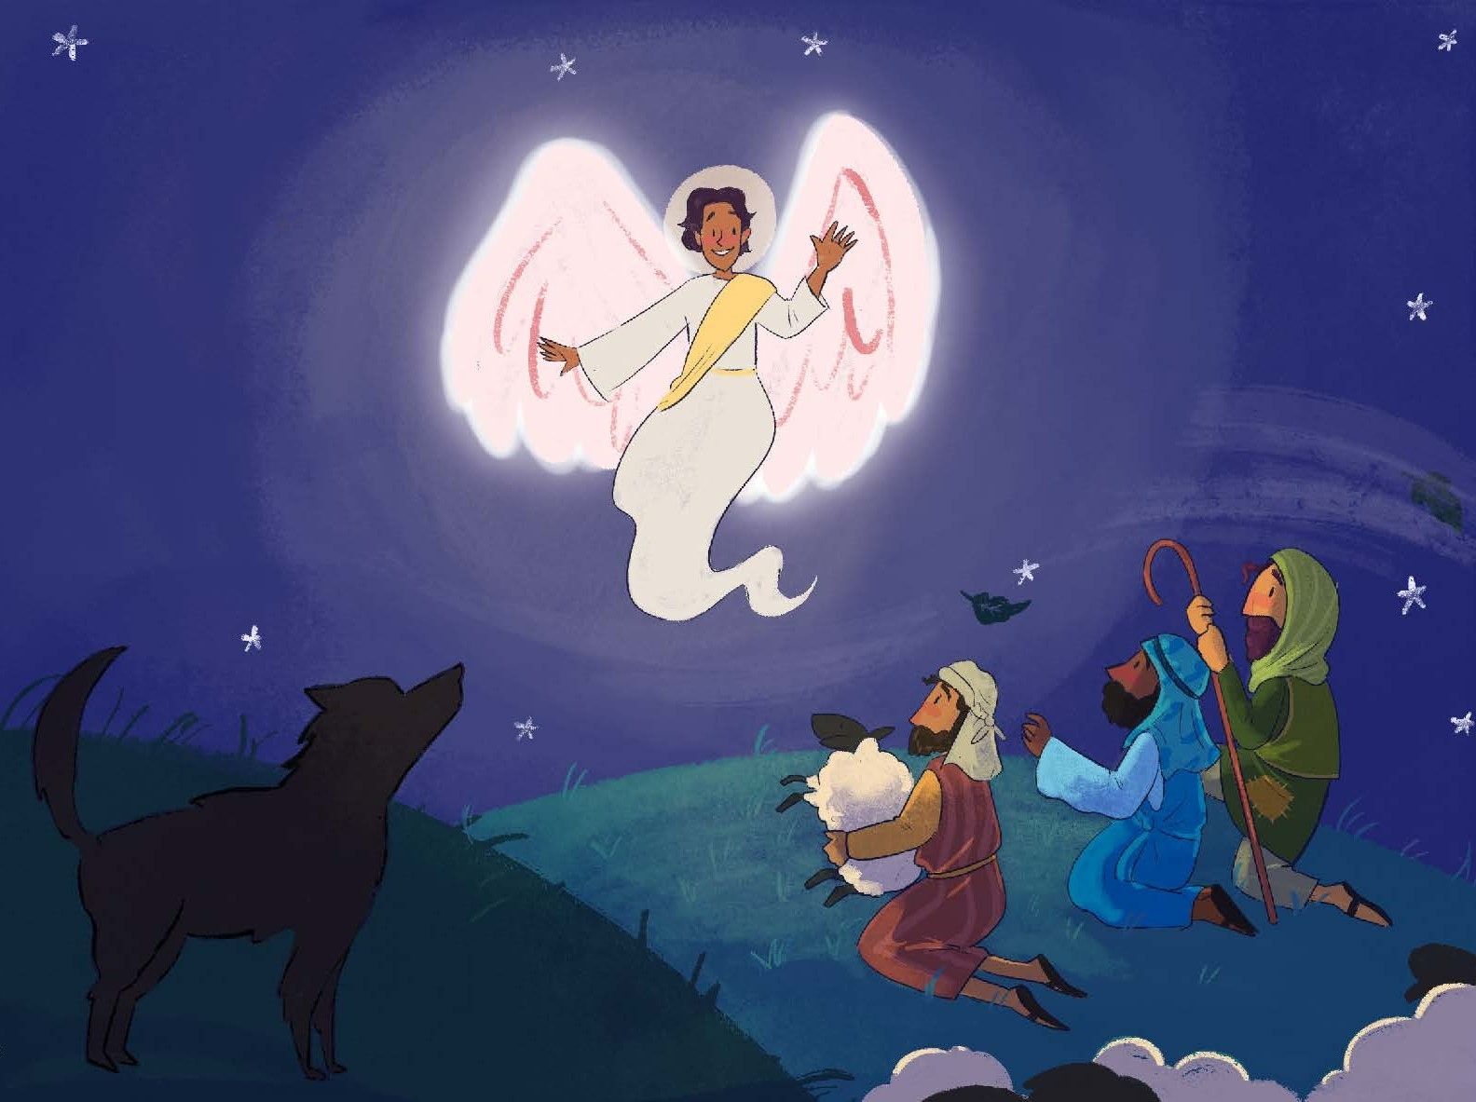

Slide 18
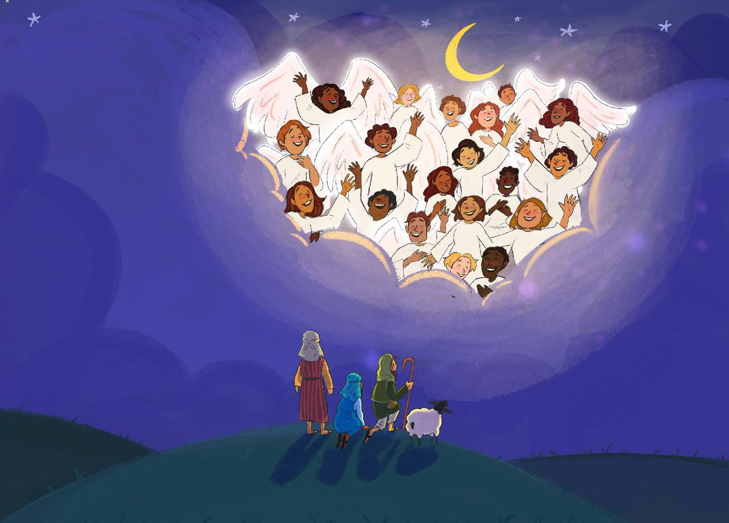

Slide 19
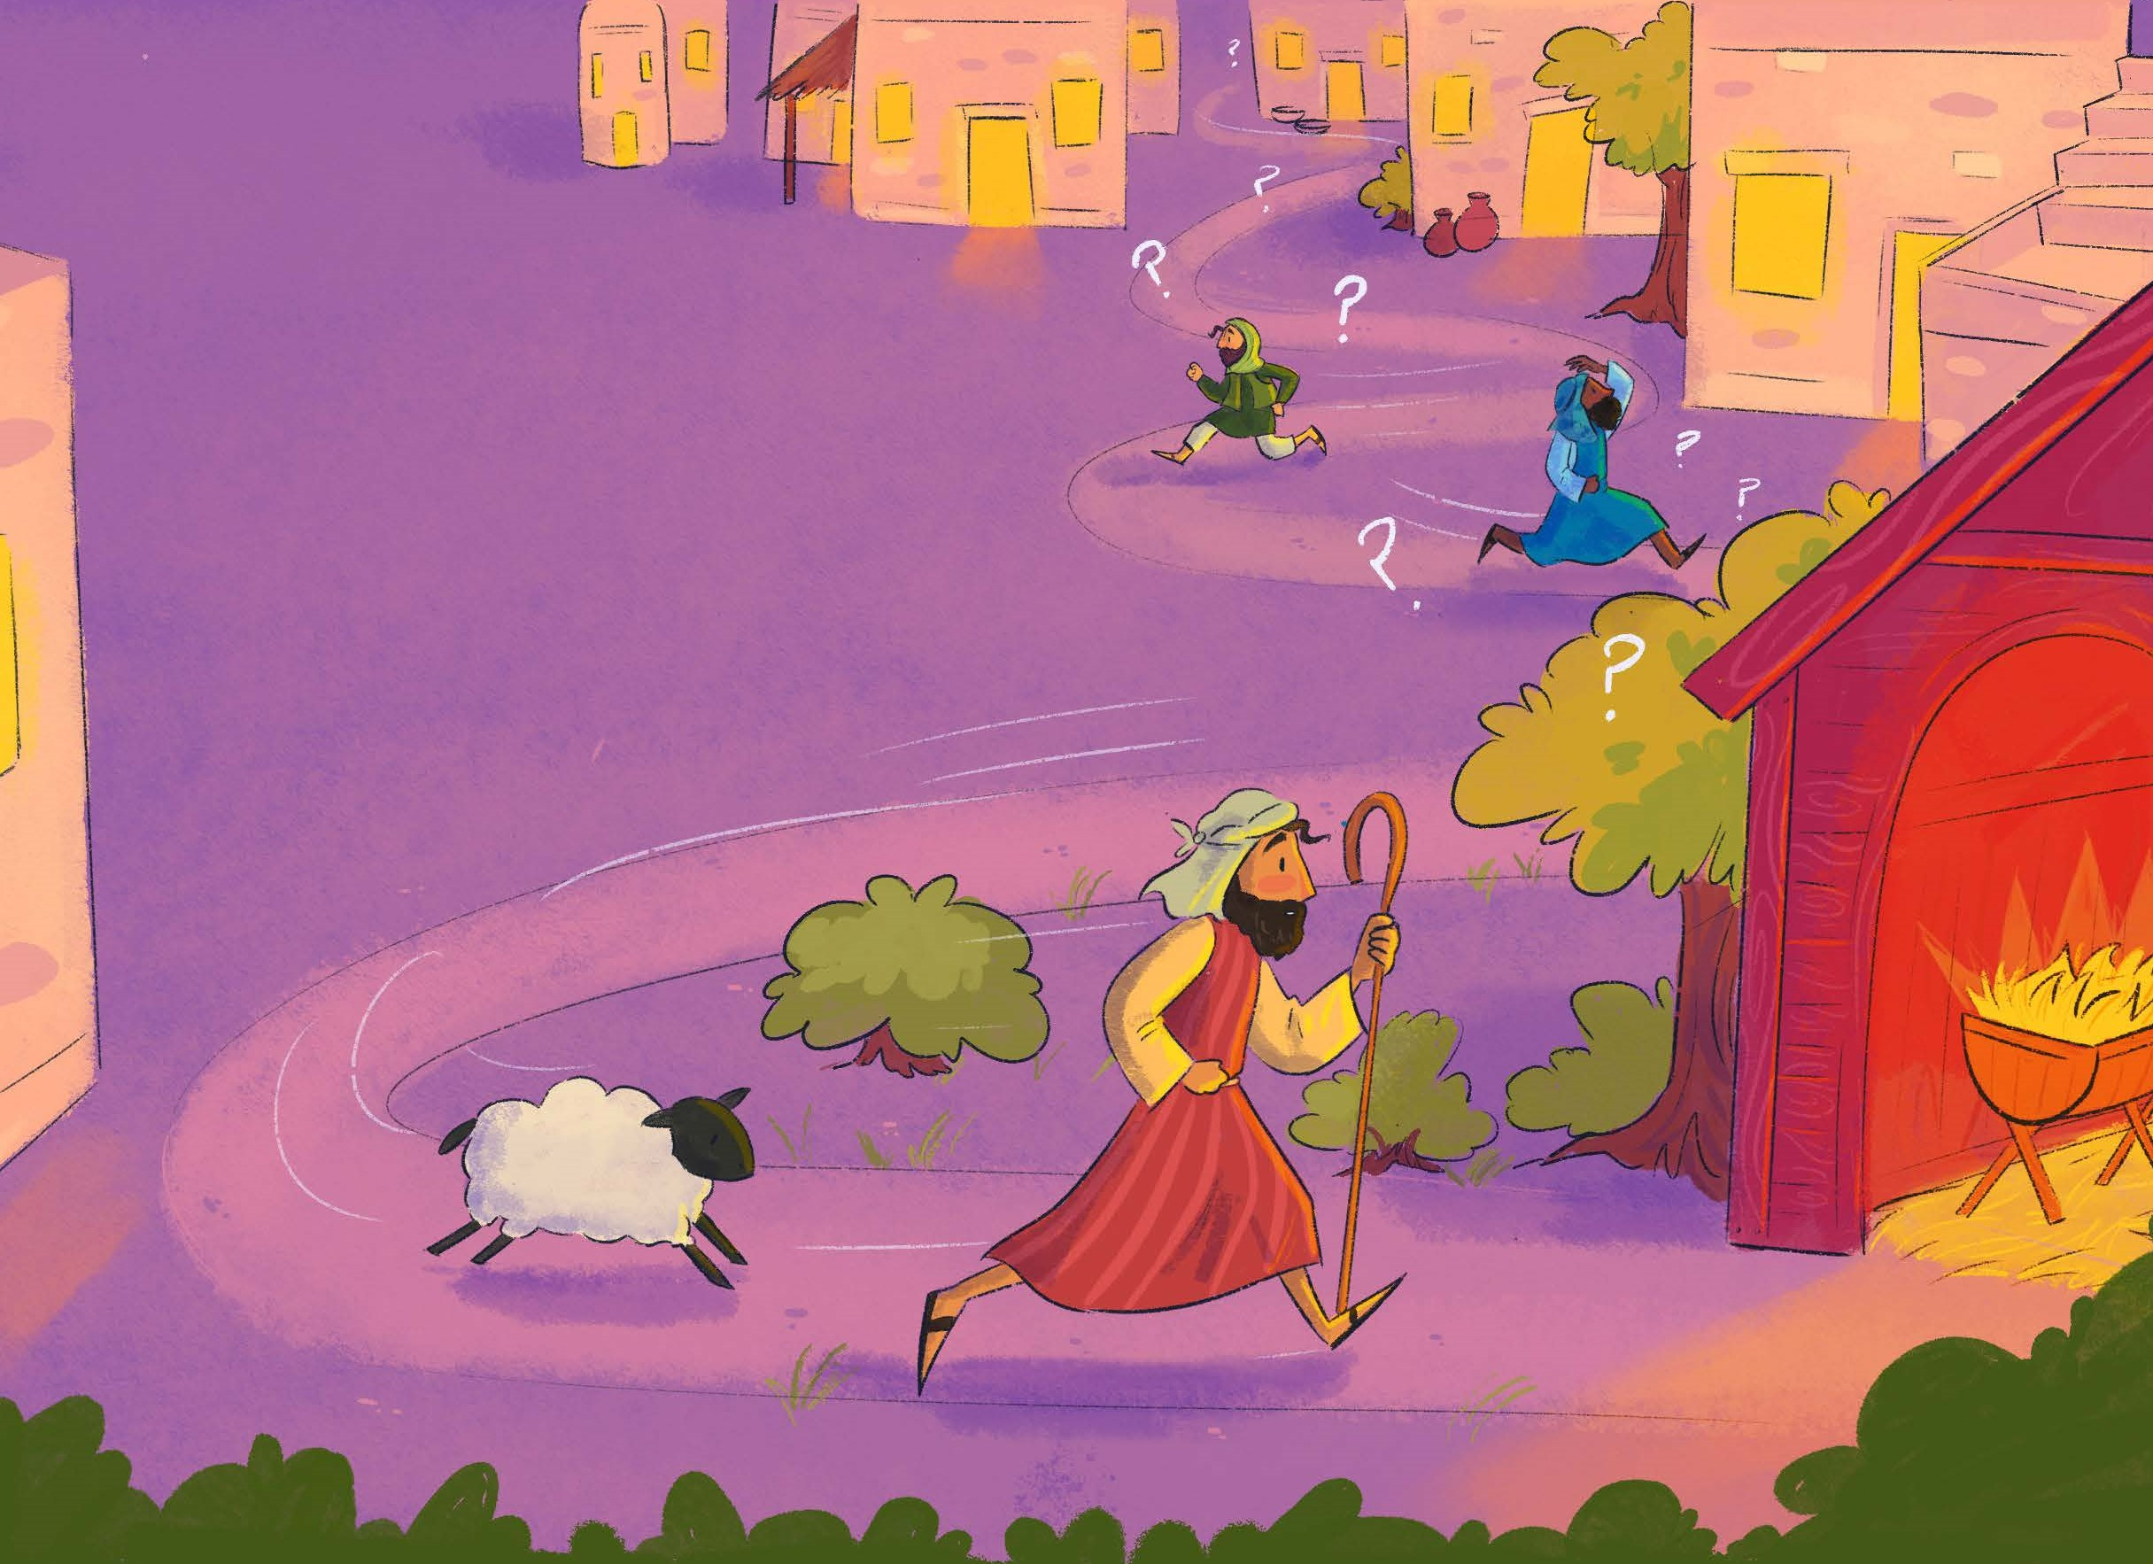

Slide 20
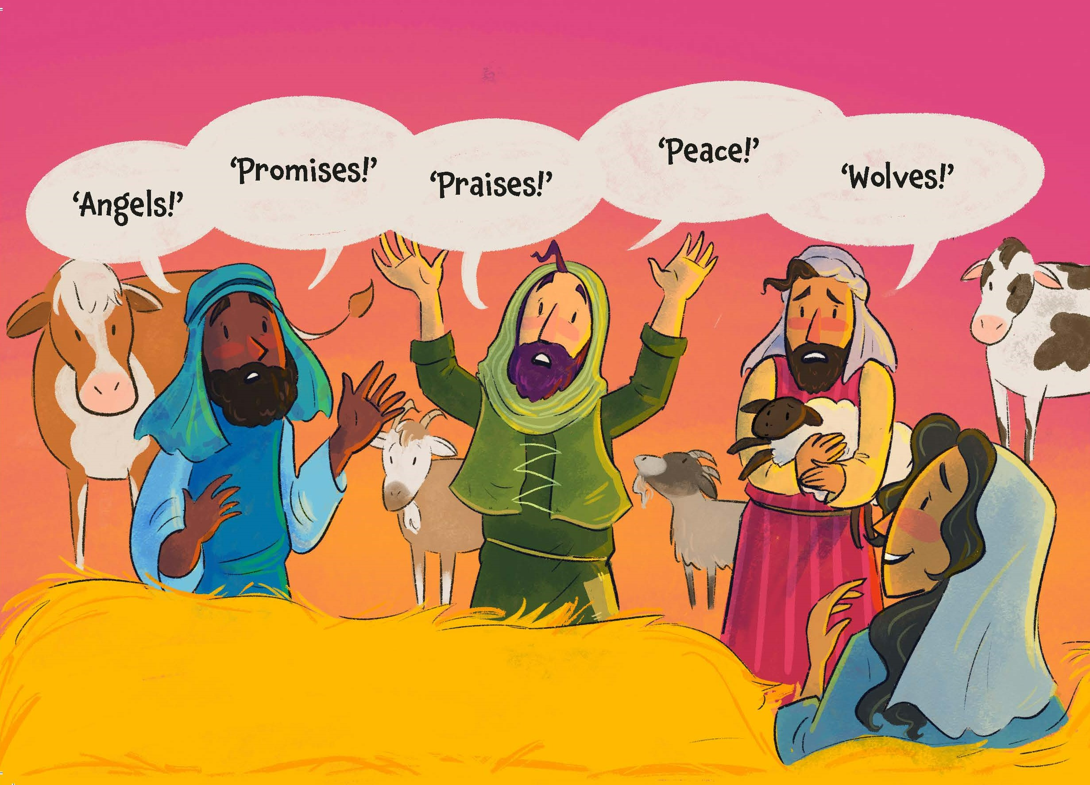

Slide 21
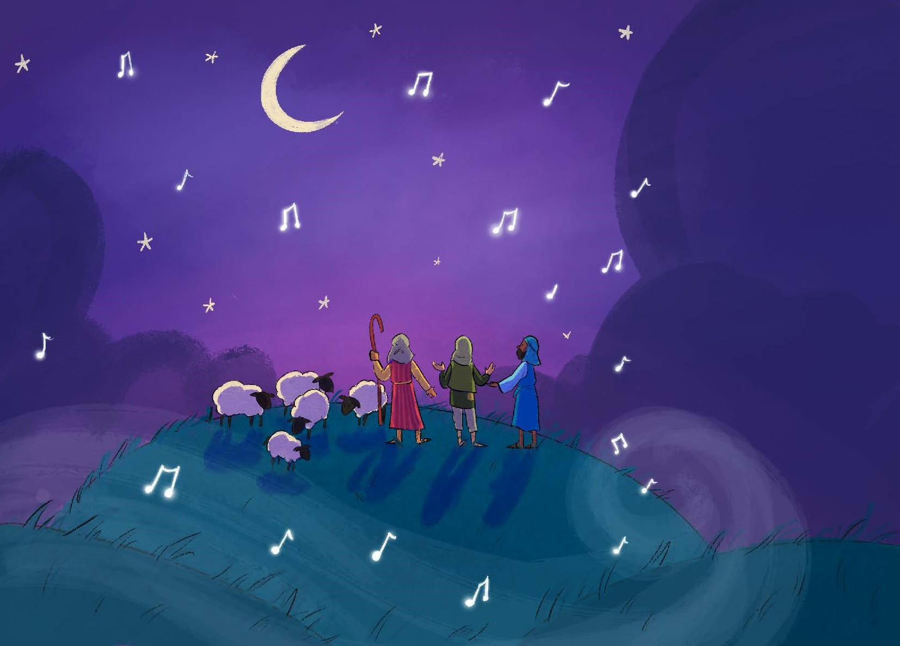

Slide 22
Children sing:
Tonight while all the world was sleeping

Slide 23
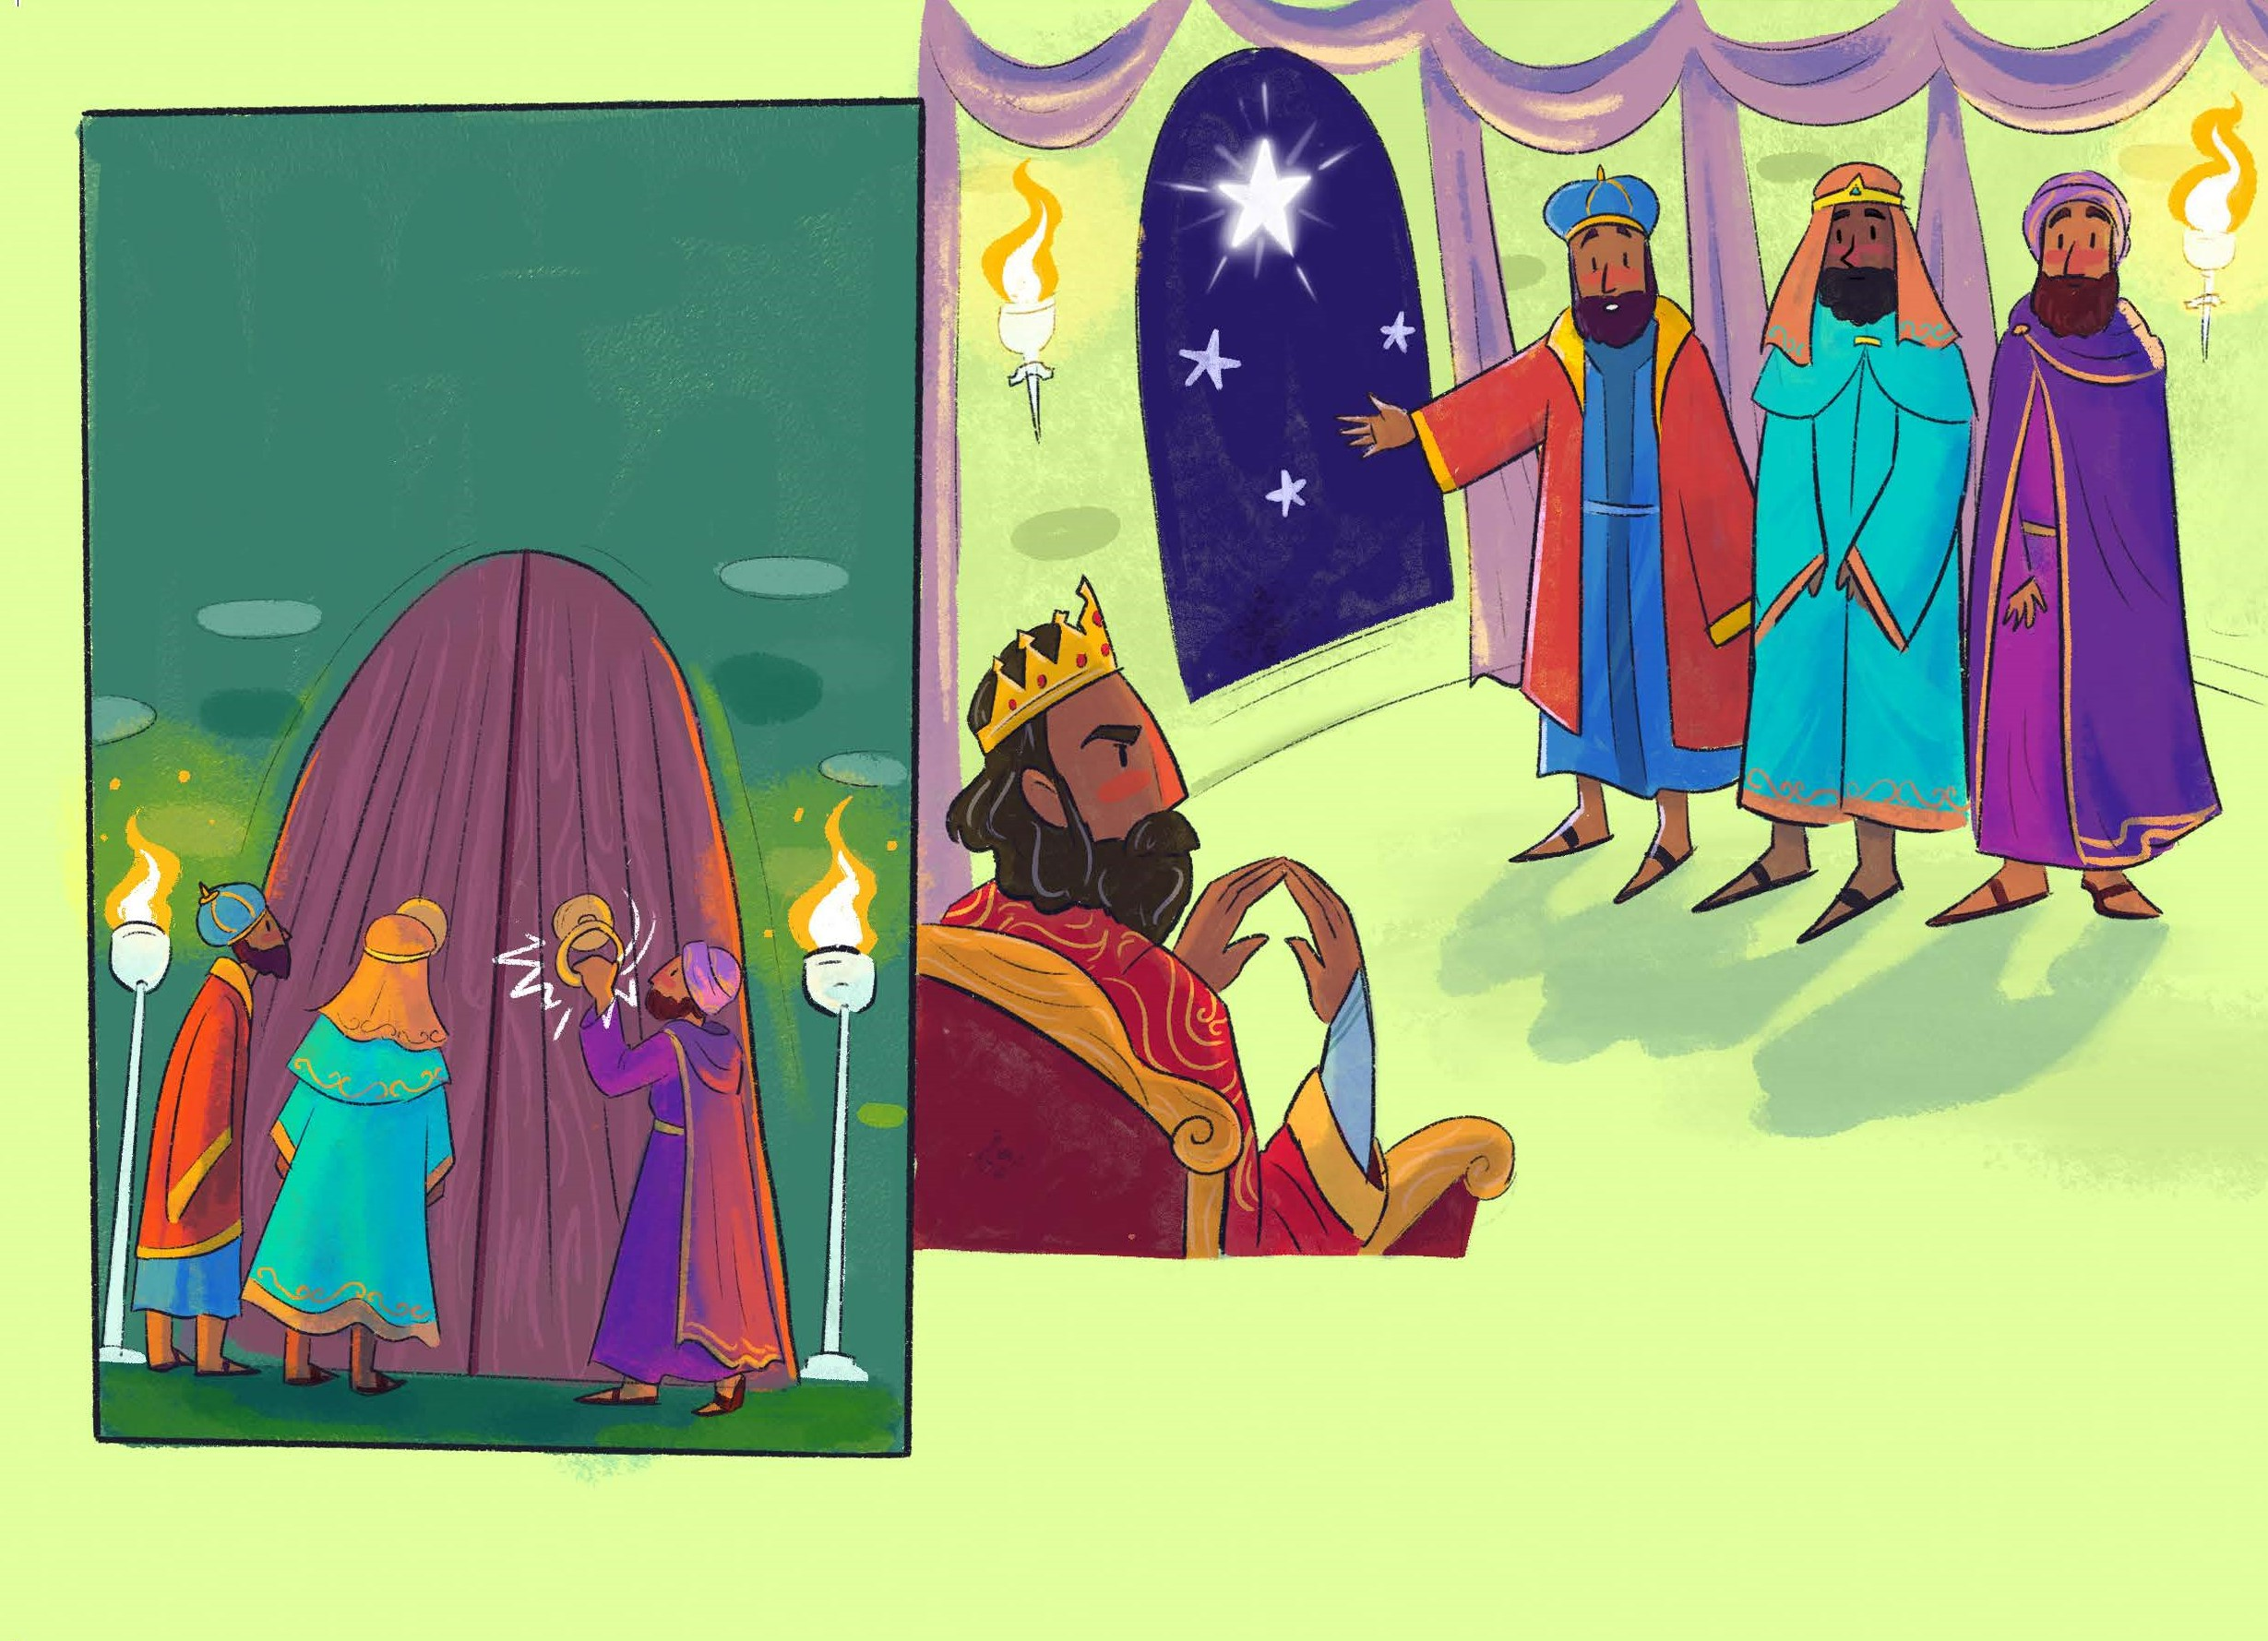

Slide 24
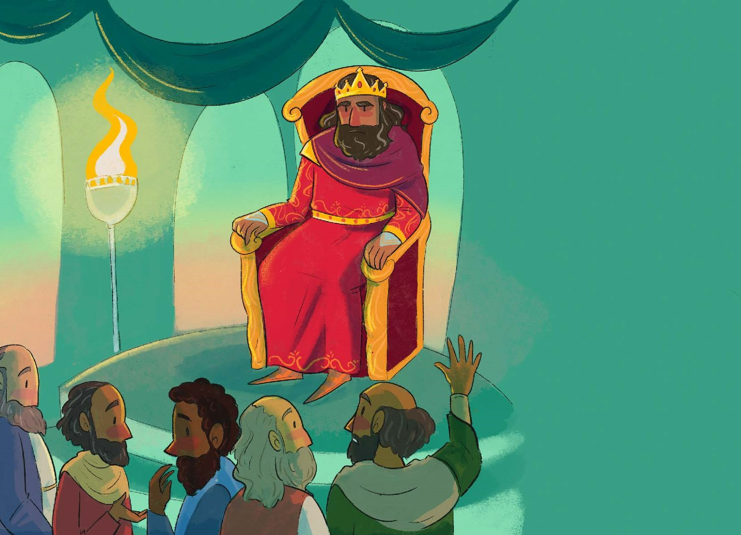

Slide 25
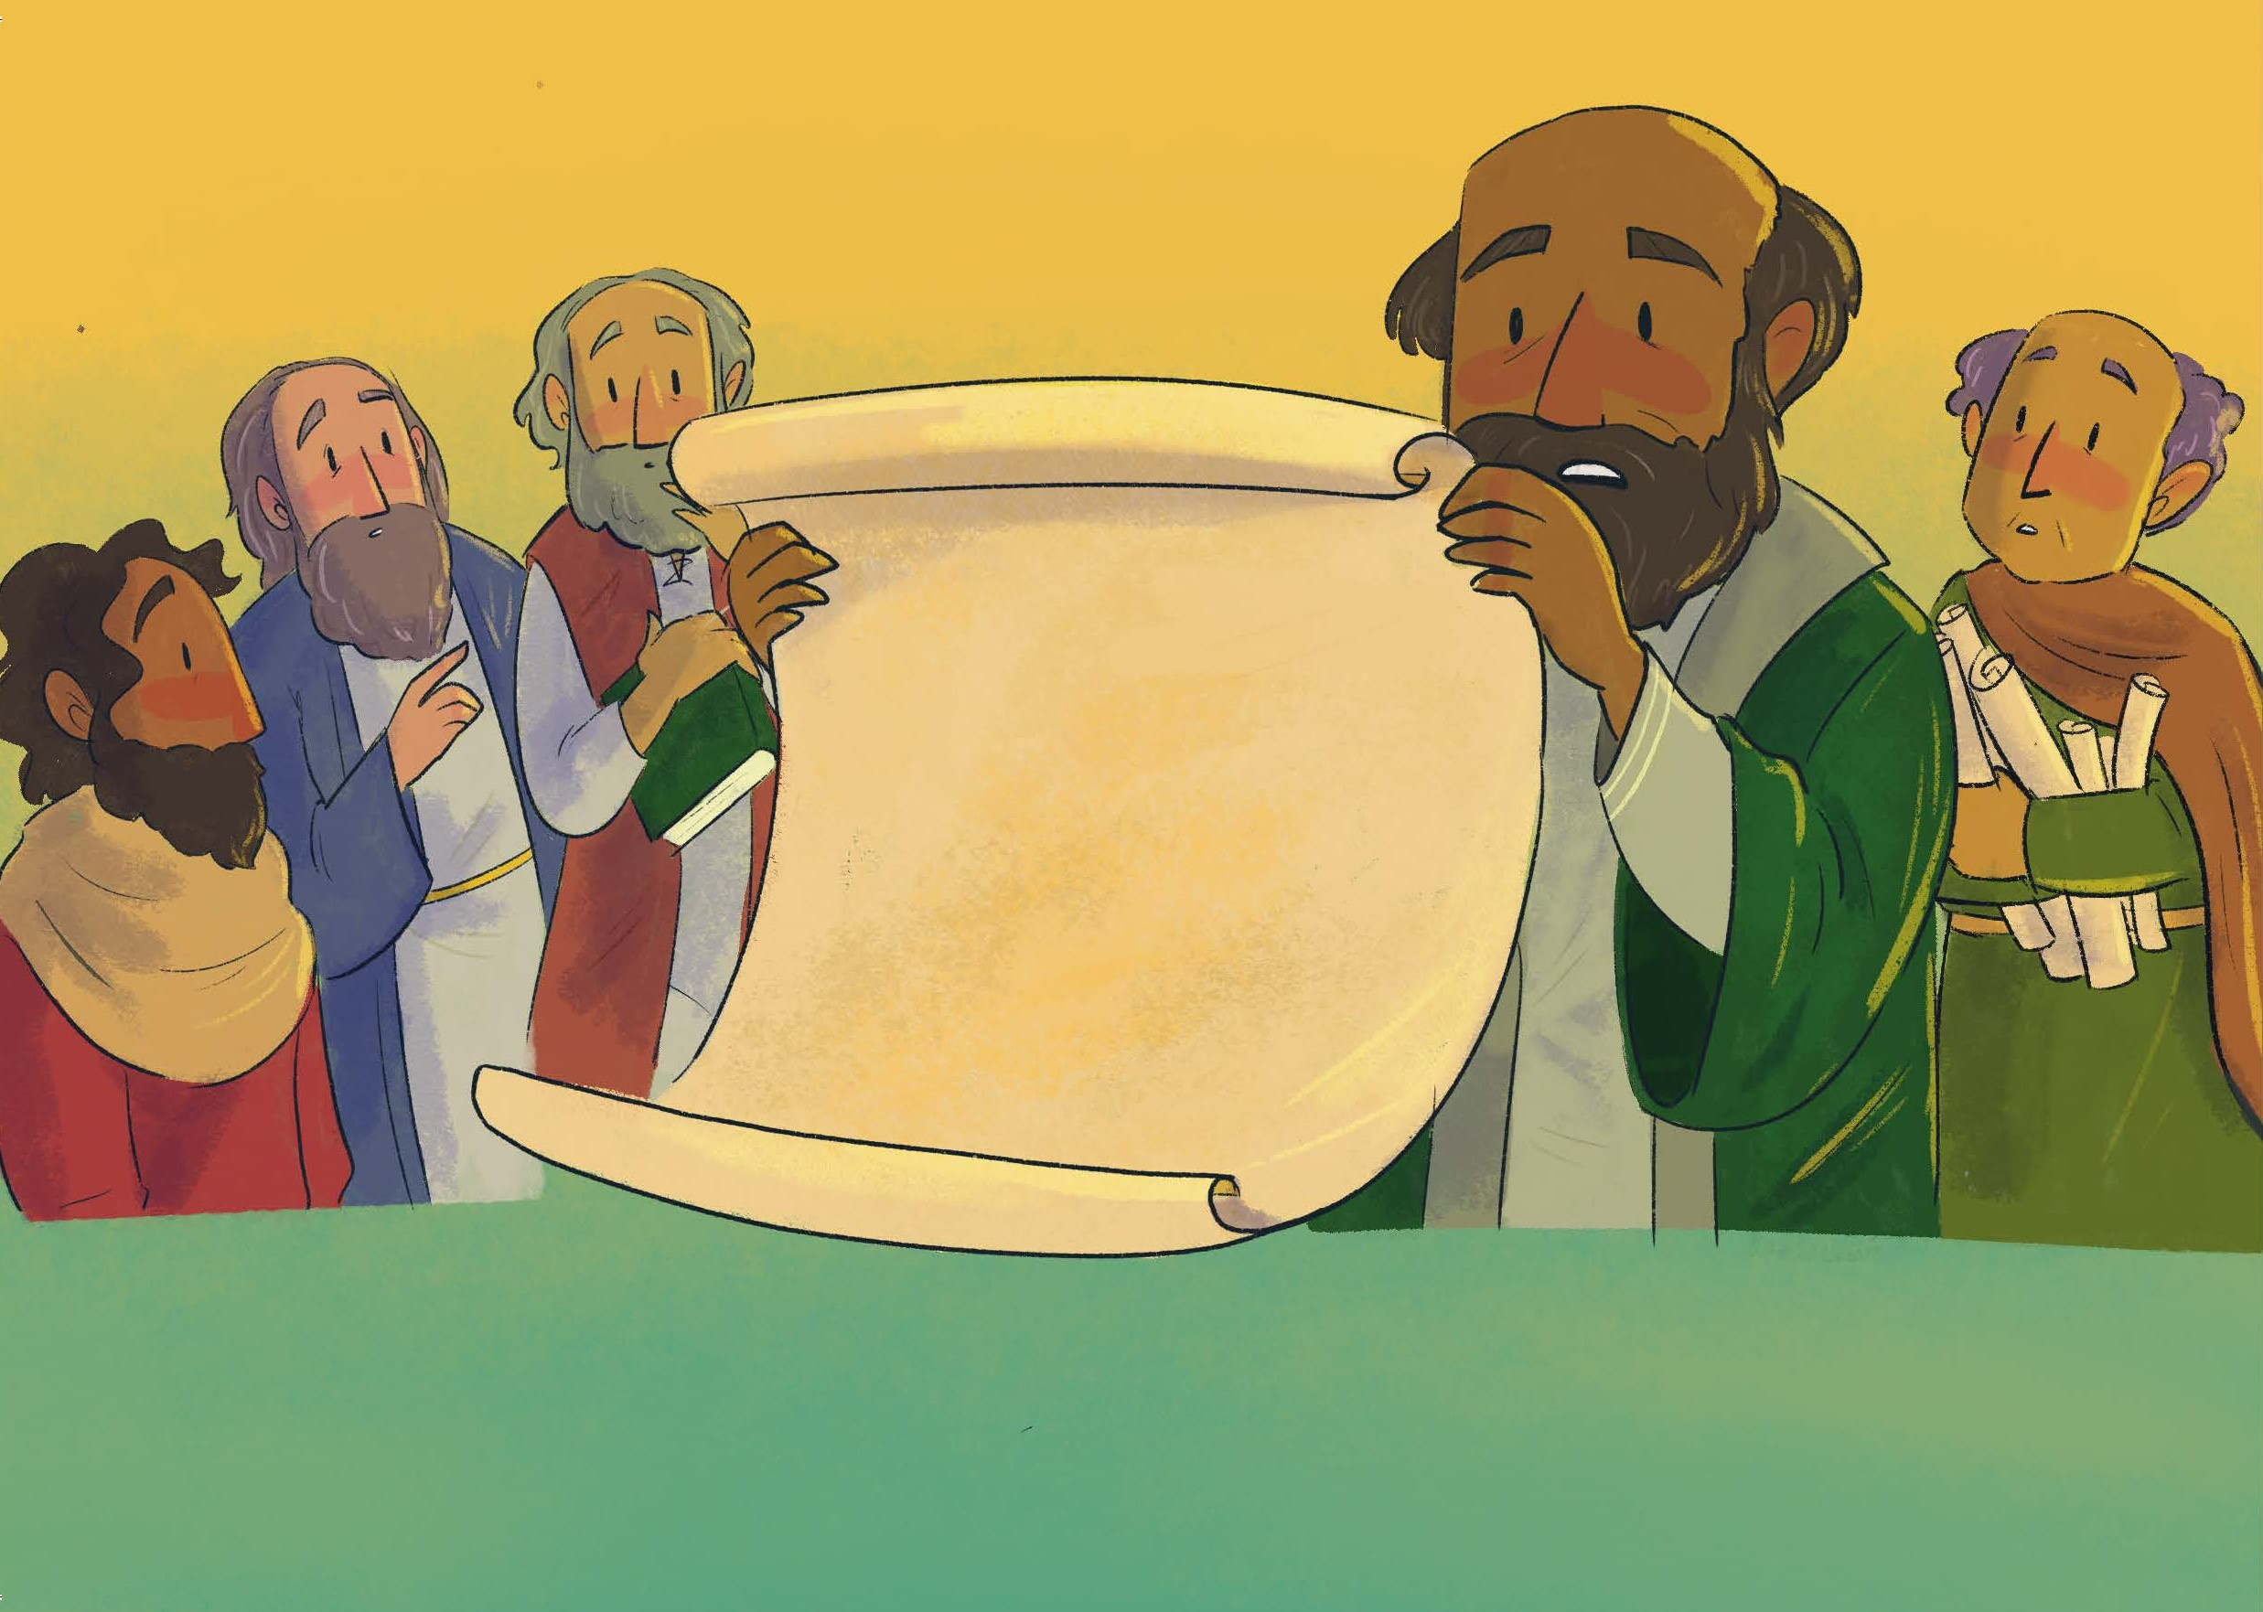

Slide 26
We three kings

Slide 27
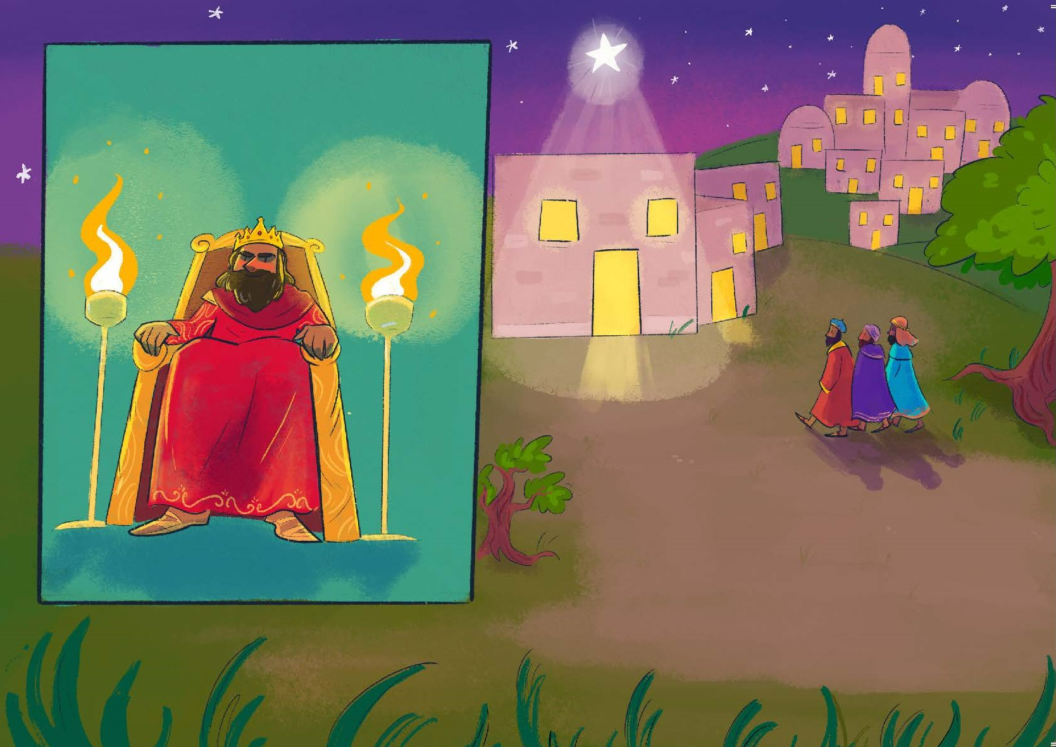

Slide 28
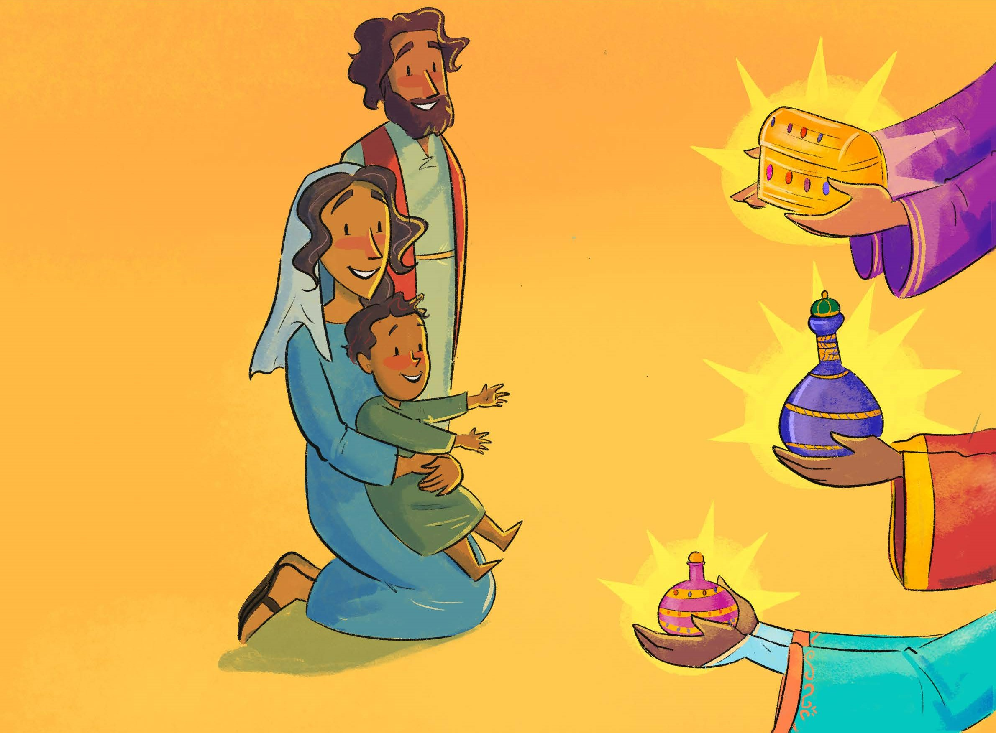

Slide 29
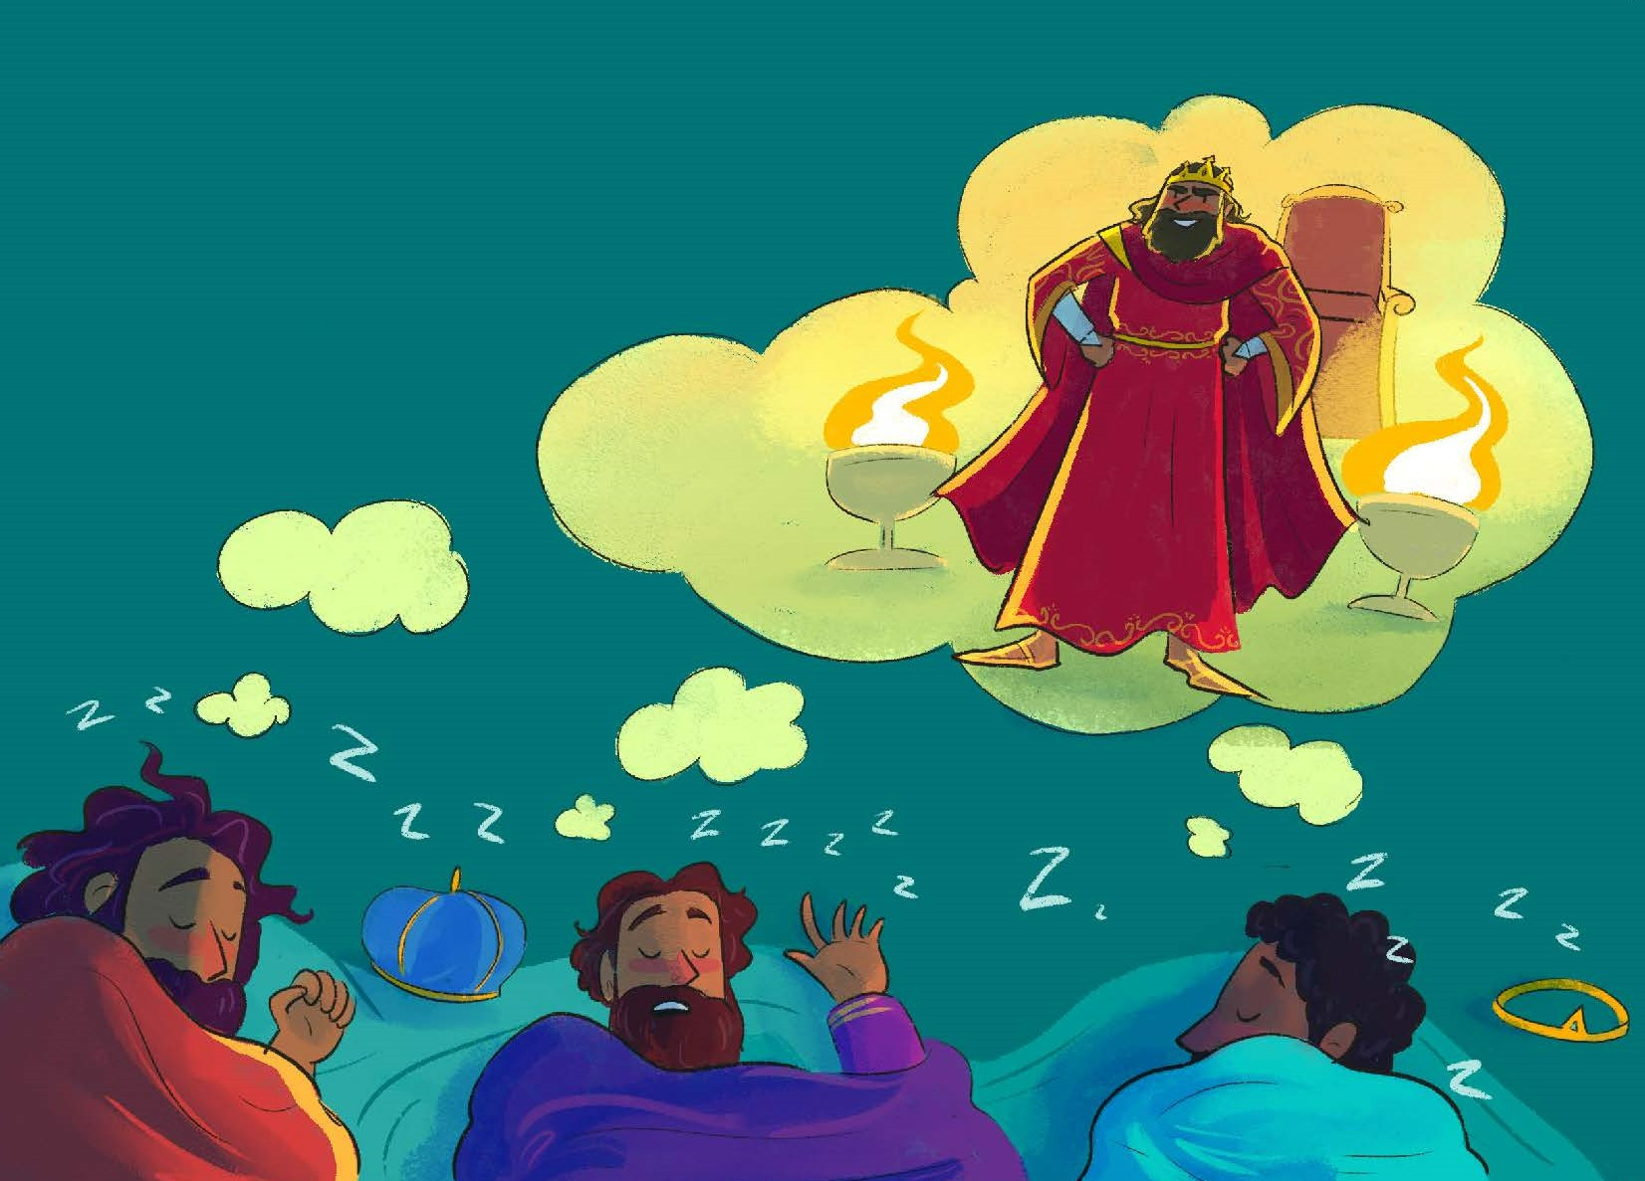

Slide 30
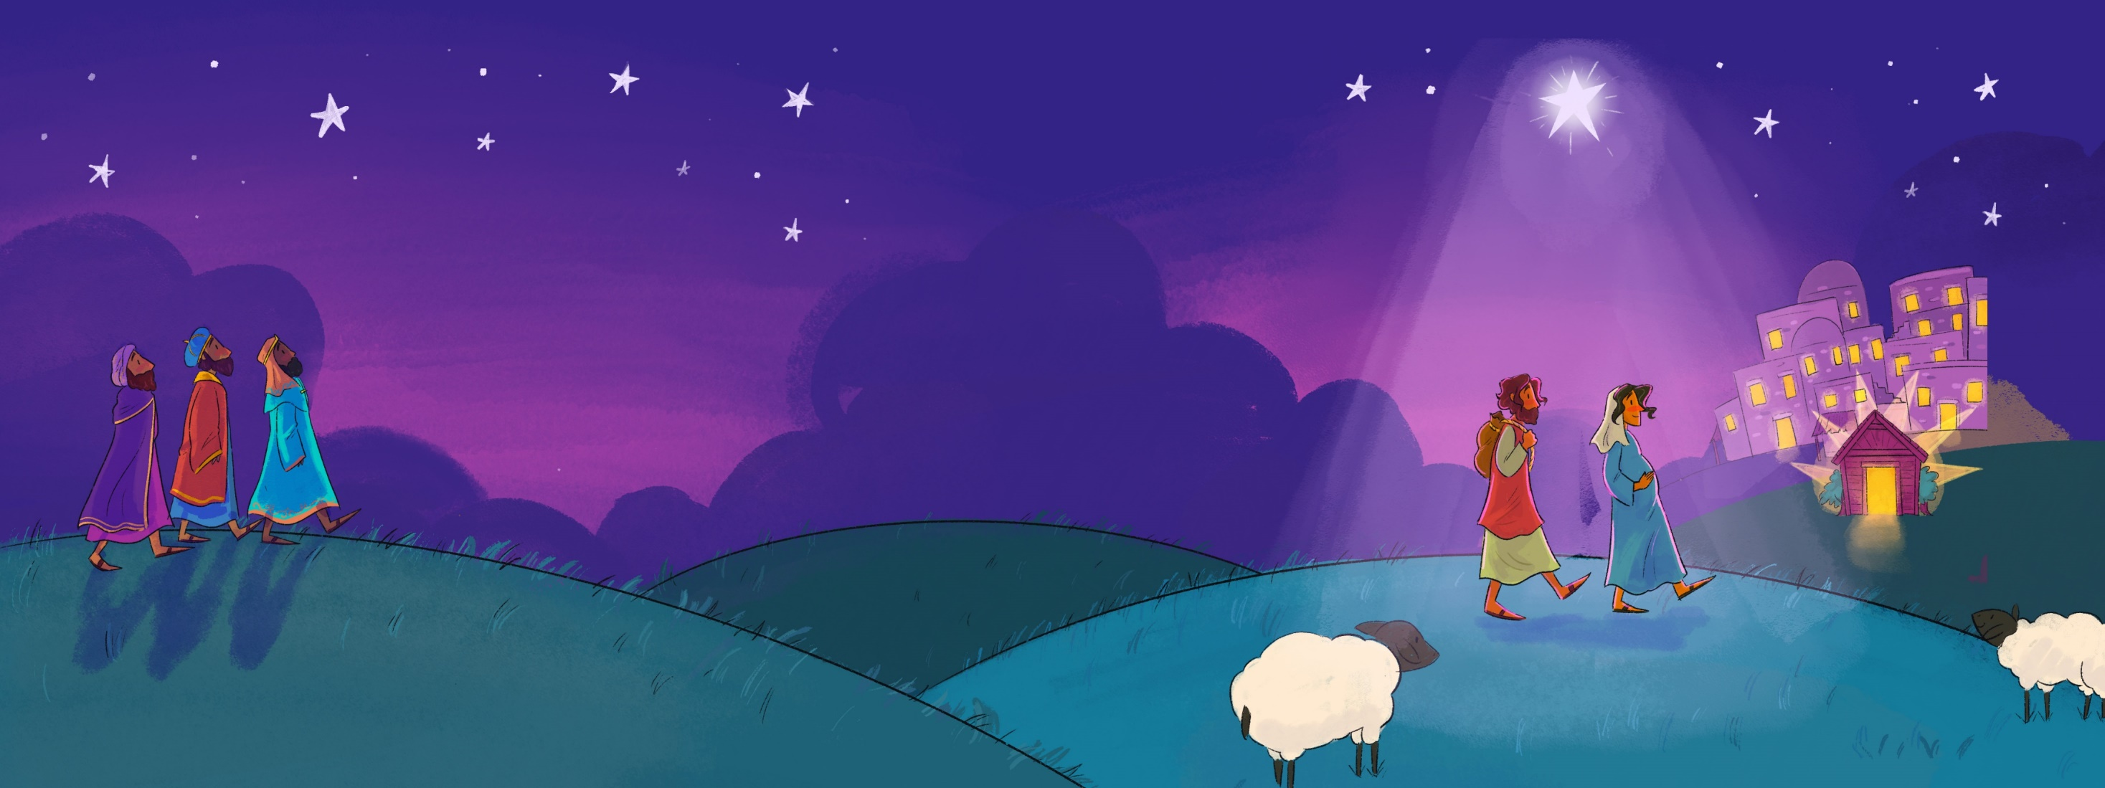

Slide 31
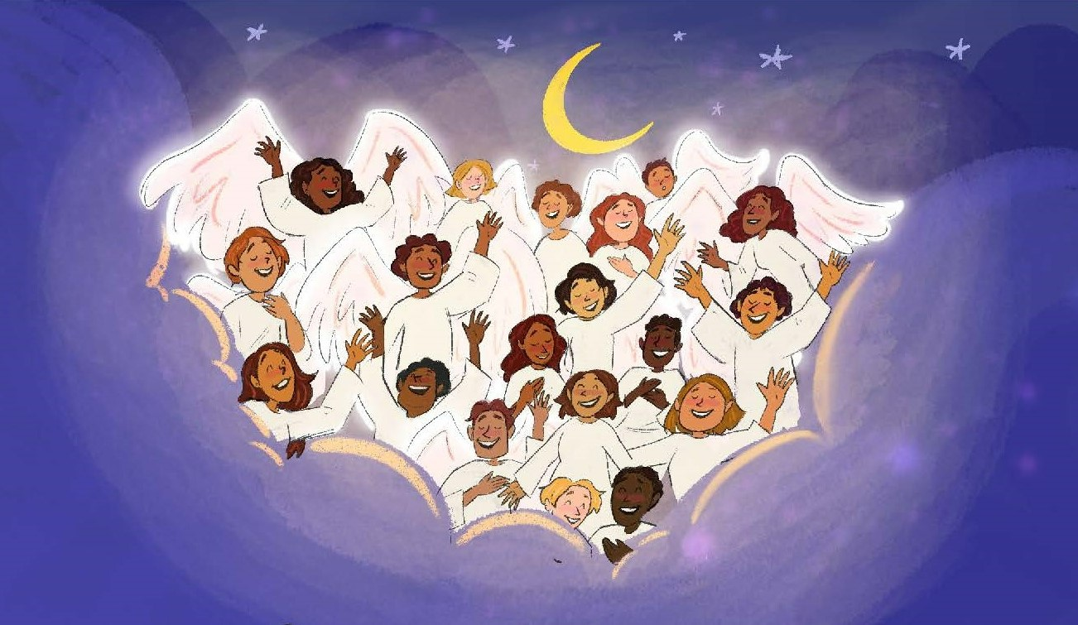

Slide 32
‘So what is the point of angels and shepherds
And camels and stars?’ you say.
‘Is it just a nice story to tell to the children
To celebrate Christmas Day?’
It’s not just a story. It’s not just for kids.
It’s the hinge on which history swings!
That Bethlehem baby grew into a man
Who challenged all powers and kings.
He taught us that love is better than hate,
That serving beats being ‘in charge’.
He showed us the value of each human life:
The little as well as the large.

Slide 33
And then, on a cross, he died for that dream,
Died to take all our wrongs away.
And walked, three days later, right out of his tomb
To turn death’s dark night to day.
And that is the good news the angels told:
The heart of all Jesus would do.
A new life for now. A new life forever.
It is his Christmas present to you!
So when things around you look awful (Awful!)
And you just don’t know what to do,
Turn to Jesus this Christmas,
His love is amazing (Amazing!) for you.

Slide 34
Hark! The Herald Angels sing

